Slide 1

IOT PATIENT HEALTH MONITORING
METHOD OF IMPLEMENTATION
INTRODUCTION
Parts needed:
ESP32 WEBSERVER
1× Breadboard
1xDS18B20 waterproof temperature sensor
1XMAX30100 heart rate and pulse oximetry sensor
1× Buzzer 10× Connecting Wires
1XBME280 temperature and humidity sensor
Connecting the three sensors to webserver through ESP32
Uploading the Code
Giving Input Parameters Observing the Results in Web
IoT (Internet of Things) Patient Health Monitoring entails the use of networked devices to gather and send patient health data to a central system for tracking and evaluation. Because of the ESP32's integrated Wi-Fi and Bluetooth capabilities, it is a popular and adaptable microcontroller for Internet of Things applications. Here, a web server for tracking patient health can be built using an ESP32.
SUBMITTED BY :
L.DEEPAK JOY – U21CS063
PROJECT DESCRIPTION
OBJECTIVE
The primary objectives of IoT Patient Health Monitoring through an ESP32 Web Server, incorporating parameters such as Oxygen Saturation (SpO2), Heart Rate (BPM), Body Temperature, Room Humidity, and Room Temperature, includes Enabling real-time monitoring of vital signs, including SpO2, BPM, body temperature, room humidity, and room temperature.
In this project, we are going to learn how to create an IoT based health monitoring system using ESP32 Microcontroller with built in WiFi and Bluetooth to display health data

Slide 2
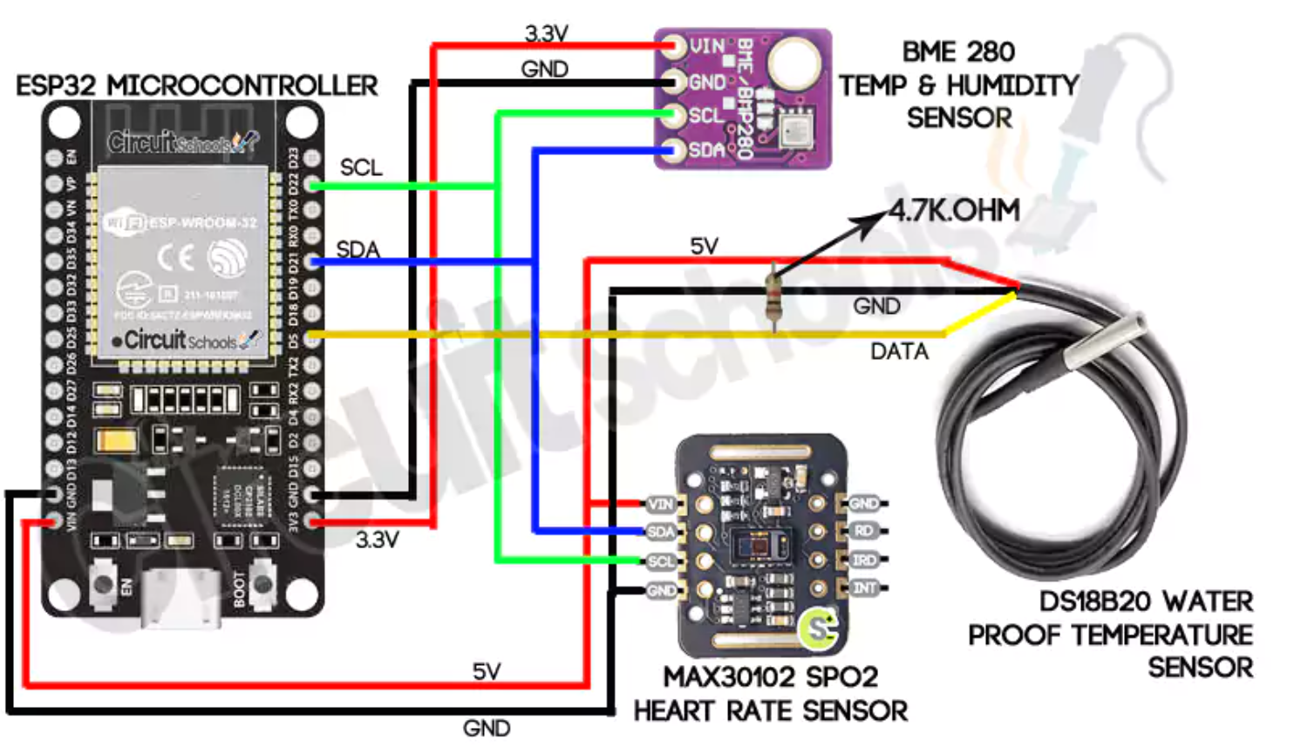
CIRCUIT DIAGRAM
RESULT
The system enables early detection of health issues or abnormalities, allowing for timely intervention and reducing the risk of complications.
SUMMARY
IoT patient monitoring leverages Internet of Things (IoT) technology to continuously monitor and collect vital health data from patients. The integration of sensors, microcontrollers (such as ESP32), and web servers enables real-time tracking of key health parameters, contributing to improved healthcare management
0
REFERENCES . www.circuitschools.org
As per the connections mentioned we have made the above circuit carefully. After, implementation of this circuit we can see the result.

